Slide 1
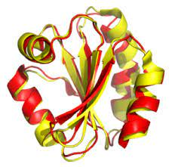
PHYSICOCHEMICAL PROPERTIES OF PROTEIN TERTIERY STRUCTURE
A REGRESSION PROJECT CASE STUDY
By
Arghyamalya Biswas
Shubha Sankar Banerjee
Suryasis Jana
Soumyadip Sarkar
Sayan Bhowmik

Slide 2
DATA DESCRIPTION
Trying to predict RMSD with the help of F1,F2,...,F9.
The variable of concern under the setup are listed as follows:
• RMSD- Size of the residue
• F1- Total Surface area
• F2- Non polar exposed area
• F3- Fractional area of exposed non polar residue
• F4- Fractional area of exposed non polar part of the residue
• F5- Molecular mass of weighted exposed area
• F6- Average deviation from standard exposed area of residue.
• F7- Euclidean distance
• F8- Secondary structure penalty
• F9- Spatial Distribution constraints (N, K- value)

Slide 3
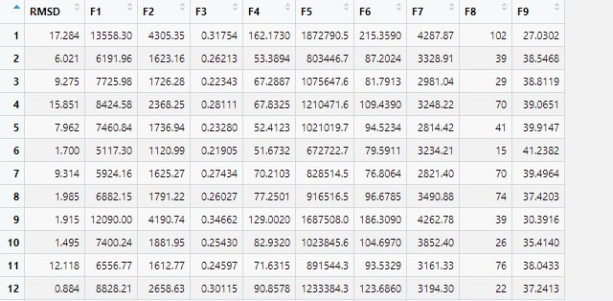
GLIMPSE OF DATASET
RESPONSE
VARIABLE
REGRESSOR VARIABLES

Slide 4

EXPLORATORY DATA ANALYSIS

Slide 5
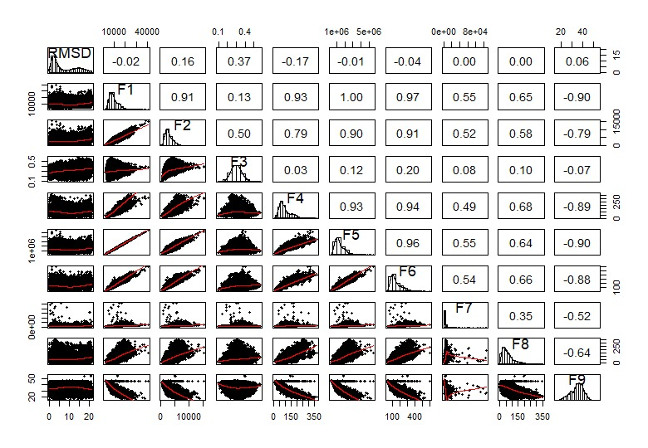
Extent of association among regressor and response variables
Histogram
Scatter diagrams
Correlation Coefficient

Slide 6
Data Characteristics
The response variable(RMSD) is positively skewed which indicates the presence of some outliers.

Slide 7
Data Characteristics
The response variable(RMSD) is positively skewed which indicates the presence of some outliers.
Among the regressor, only F3 and F9 are almost symmetrically distributed and others are positively skewed.

Slide 8
Data Characteristics
The response variable(RMSD) is positively skewed which indicates the presence of some outliers.
Among the regressor, only F3 and F9 are almost symmetrically distributed and others are positively skewed.
None of the individual regressor is found to be highly correlated with the response variable.

Slide 9
Data Characteristics
However some of the pairs of regressors are supposed to be highly correlated viz.
– F1 has high positive correlation with F2,F4,F5,F6,F8 and high negative correlation with F9. Moreover F1 is perfectly correlated with F5 in a positive way.
– F2 is positively correlated with F4,F5,F6 and negatively correlated with F9.
– F4 has positive correlation with F5,F6,F8 and negative correlation with F9.
– (F5,F6),(F5,F8) pairs have positive correlation and (F5,F9) has negative correlation.
– F6 is positively correlated with F8 and negatively correlated with F9.
– And finally F8 and F9 share a negative correlation.

Slide 10
FITTING THE MLR MODEL

Slide 11
MODEL INITIALISATION
We initialise our analysis with the model
y_{i} = β₀ + Σ_{j} β_{j} x_{ij} + ε_{i}
for all i = 1(1)n
E(ε_{i}) = 0 , for all i = 1(1)n
Var(ε_{i}) = σ² , for all i = 1(1)n ASSUMPTIONS
Cov(ε_{i} , ε_{k}) = 0 , for all i,k = 1(1)n and i ≠ k

Slide 12
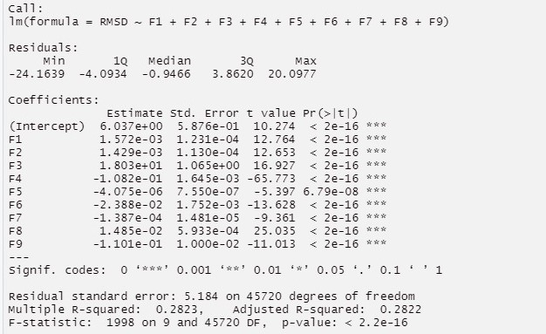
TESTS FOR SIGNIFICANCE OF REGRESSION
SUMMARY OF THE ESTIMATED MLR MODEL

Slide 13
OBSERVATIONS
We can clearly see that the p-values of all the parameter estimates are less than 0.05. Thus at 95% of significance we can conclude that all the paramater estimates are statistically significant.

Slide 14
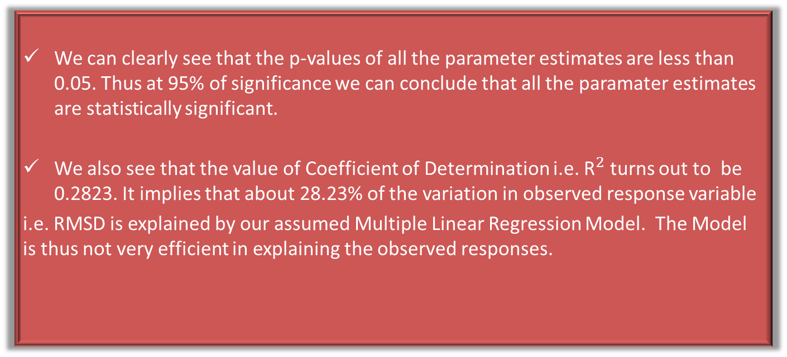
OBSERVATIONS
We can clearly see that the p-values of all the parameter estimates are less than 0.05. Thus at 95% of significance we can conclude that all the paramater estimates are statistically significant.
We also see that the value of Coefficient of Determination i.e. ${\text{R}}^{2}$ turns out to be 0.2823. It implies that about 28.23% of the variation in observed response variable
i.e. RMSD is explained by our assumed Multiple Linear Regression Model. The Model is thus not very efficient in explaining the observed responses.

Slide 15
Hence after Ordinary Least Square(OLS) regression the model turns out to be:
RMSD = 6.037 + 1.572 × 10⁻³ F1 + 1.429 × 10⁻³ F2 + 18.03 F3 − 1.082 × 10⁻¹ F4 − 4.075 × 10⁻⁶ F5 − 2.388 × 10⁻² F6− 1.387 × 10⁻⁴ F7+ 1.485 × 10⁻² F8 − 1.101 × 10⁻¹ F9

Slide 16
MODEL DIAGNOSTICS

Slide 17
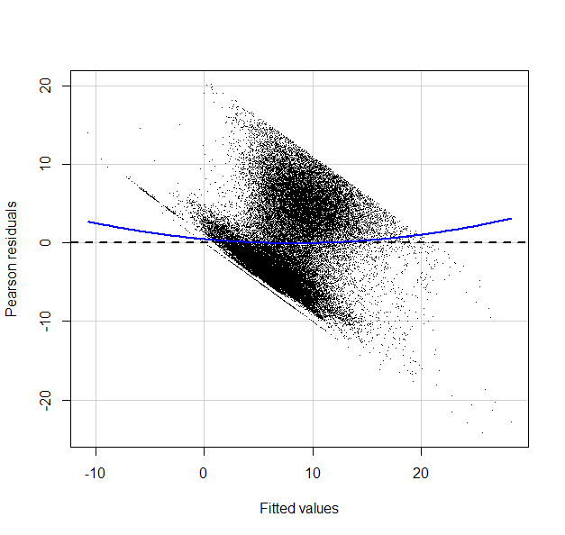
RESIDUAL ANALYSIS
Residual Plot
We can clearly see that a distinct pattern is apparent. It indicates the presence of
heteroscedasticity, i.e., the errors vary with one or more regressors.

Slide 18
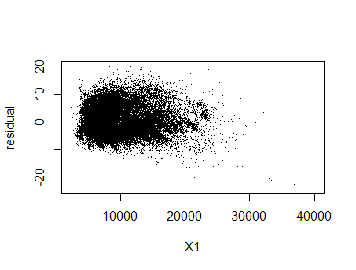
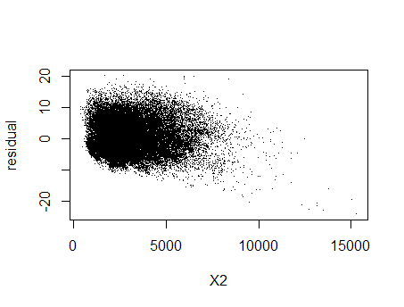
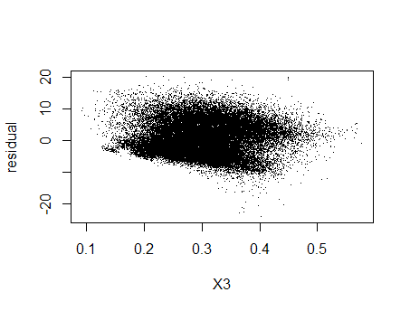
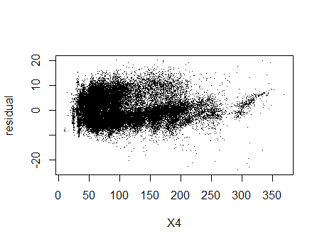
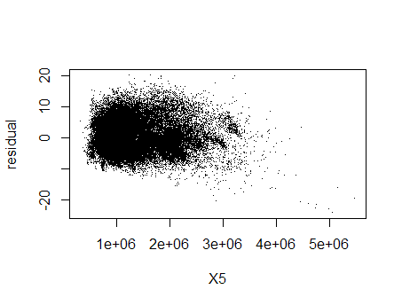
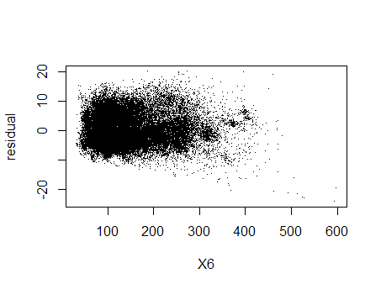
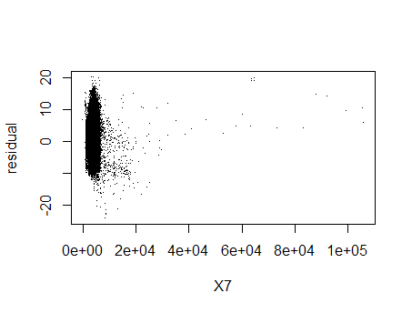
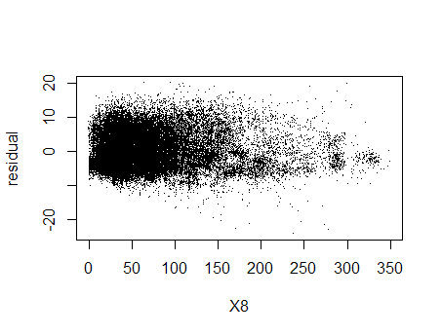
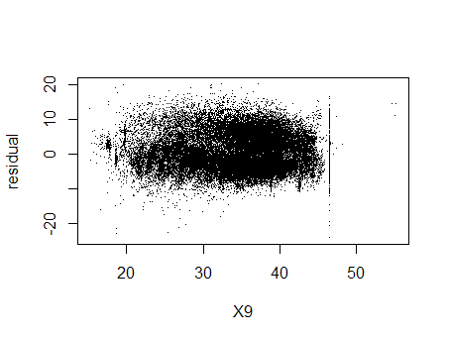
PLOTS FOR RESIDUAL AGAINST EACH REGRESSOR

Slide 19
PLOTS FOR RESIDUAL AGAINST EACH REGRESSOR
We can see that there seems to be some form of dependence of residuals on the regressors. However the nature of dependence on any of the regressors is not clear.

Slide 20
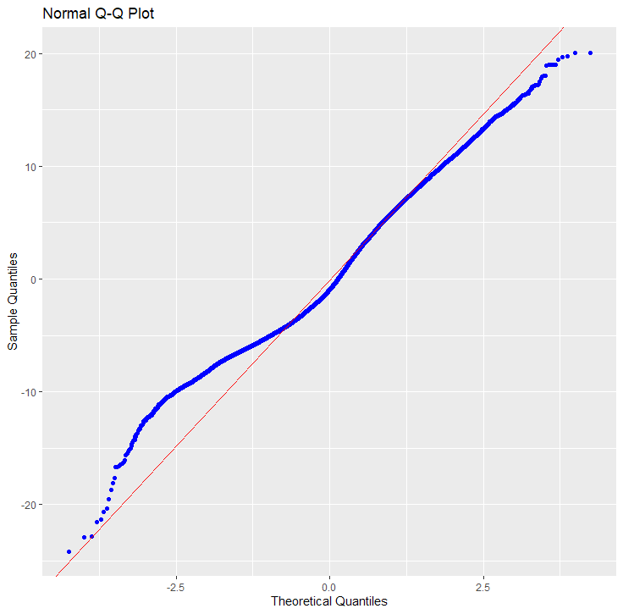
TESTING NORMALITY OF ERROR ASSUMPTION

Slide 21
TESTING NORMALITY OF ERROR ASSUMPTION
We can see that the data points do not lie entirely on the 45◦ diagonal line. Thus we can suspect that the errors are actually not normally distributed.

Slide 22

SUMMARY OF KOLMOGOROV-SMIRNOV TEST

Slide 23
SUMMARY OF KOLMOGOROV-SMIRNOV TEST
We get the value of the test statistic D = 0.075978 and the p-value as 2.2 × 10−16 which is smaller than 0.05 (testing at 95% level of significance). Thus we reject the null hypothesis in favour of the alternate hypothesis and conclude that the errors are not normally distributed.

Slide 24
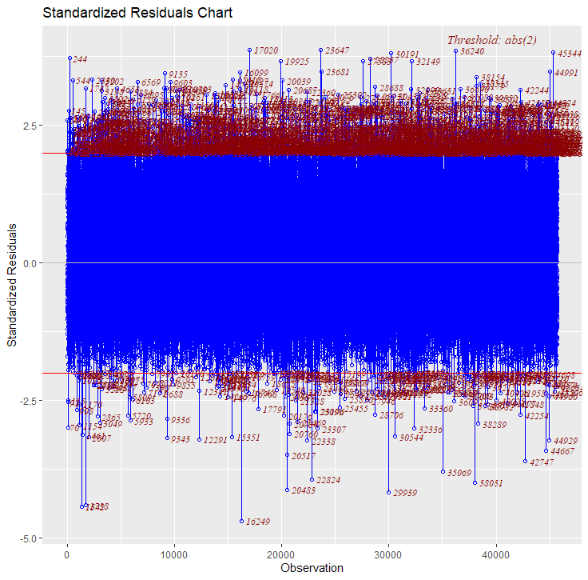
DETECTION OF OUTLIERS

Slide 25
DETECTION OF OUTLIERS
We can see that a substantial number of data points lie in regions which can indicate presence of outliers from this standardized residual chart.

Slide 26
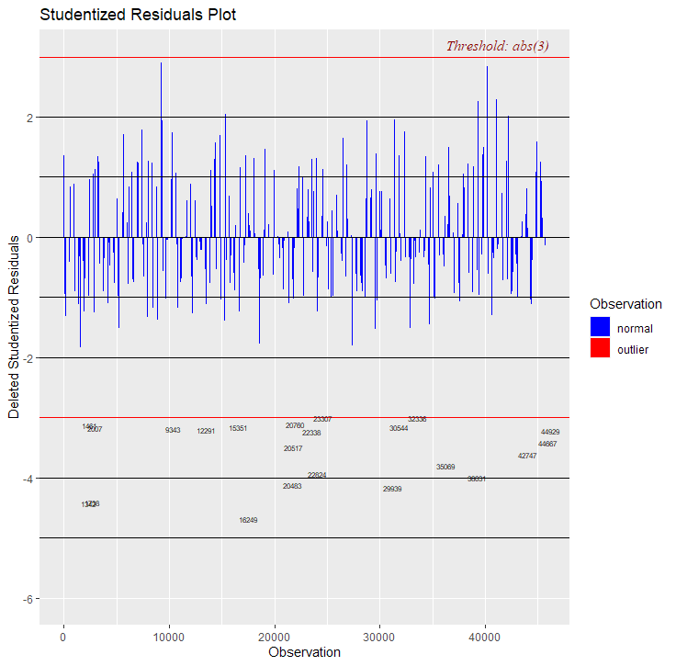

Slide 27
We can see that a few points can be believed to be possible outliers.

Slide 28
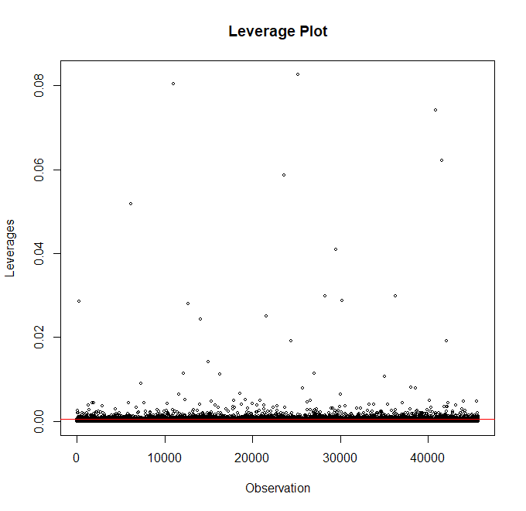
DETECTION OF LEVERAGE POINTS

Slide 29
DETECTION OF LEVERAGE POINTS
As we can see, quite a many points apparently have large leverages.

Slide 30
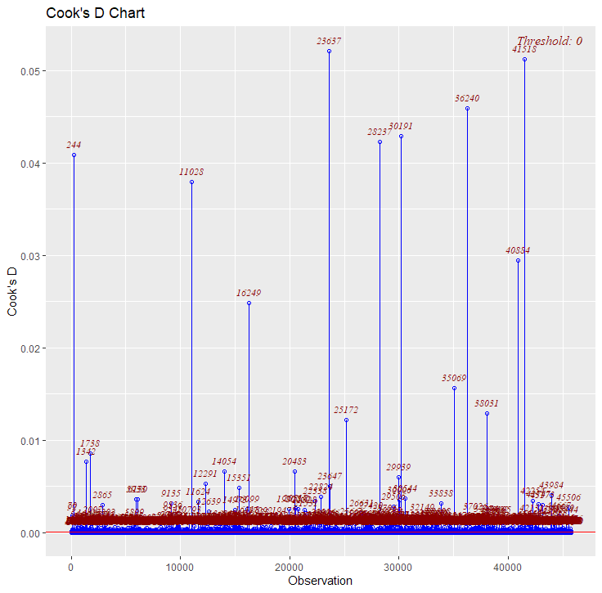
DETECTION OF INFLUENTIAL POINTS

Slide 31
DETECTION OF INFLUENTIAL POINTS
We see that there are substantial number of points which can be regarded as influential points.

Slide 32
THEREFORE NOW THE AGENDA IS :
Since we are interested in finding the true nature of the
dependence of response on the regressors, we will
drop these points.

Slide 33
THEREFORE NOW THE AGENDA IS :
Since we are interested in finding the true nature of the
dependence of response on the regressors, we will
drop these points.
We fit the MLR model again on this reduced set of data points.
The residuals are noted.

Slide 34
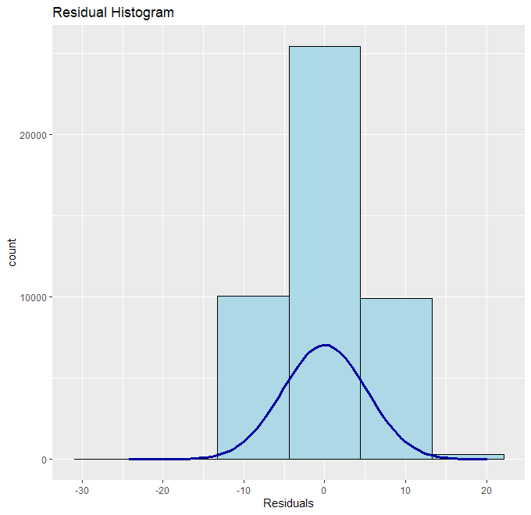
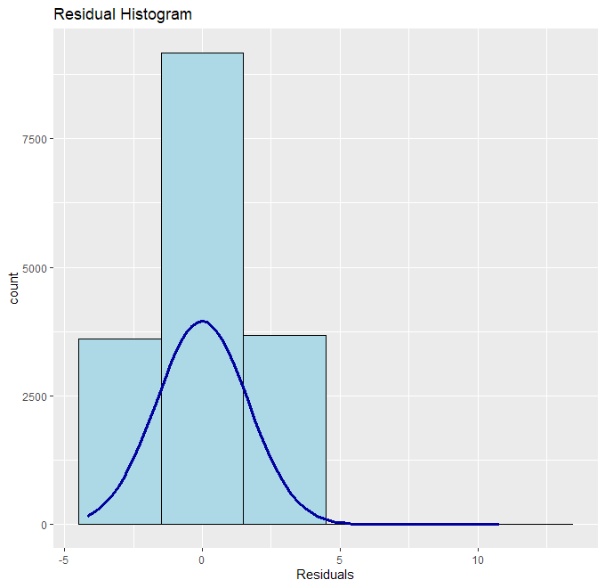
RESIDUAL HISTOGRAM ON
ORIGINAL DATASET
RESIDUAL HISTOGRAM
ON CLEANED DATASET

Slide 35
RESIDUAL HISTOGRAM ON
ORIGINAL DATASET
RESIDUAL HISTOGRAM
ON CLEANED DATASET
We can see that data points with extreme influence has been removed, as is indicated by the two histograms.
We will make our next analyses on this cleaned data set.

Slide 36
CHECKING FOR MULTICOLLINEARITY

Slide 37
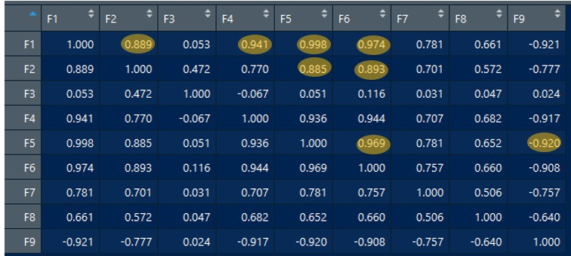
PRIMA FACIE DETECTION
CORRELATION MATRIX
Yellow marked entries in the above matrix indicate high values of pairwise correlation coefficient

Slide 38
OBSERVATION
We observe clealy that there are several entries in the matrix indicating very high value of pairwise correlation coefficient and therefore we may have enough reason to believe that our model contains multicollinearity.
Therefore We also check whether the matrix (X’X) ⁻¹ is unstable or ill-conditioned or not.

Slide 39
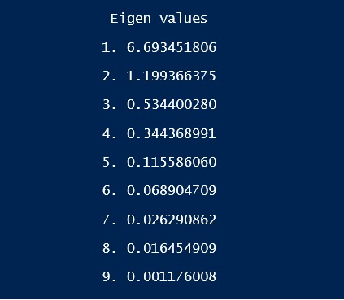
EIGEN VALUES OF X’X
It is noted that the last two eigen values (0.01645 and 0.001176) are very close to 0 and they might be responsible for the instability in the matrix (X’X)⁻¹

Slide 40
Stability of X’X
We also note the determinant of the matrix X’X given by:
|X’X| = Product of the eigen values = 5.986286 * 10⁻¹⁹
The determinant value is very close to 0 and hence is a near singular
matrix.

Slide 41
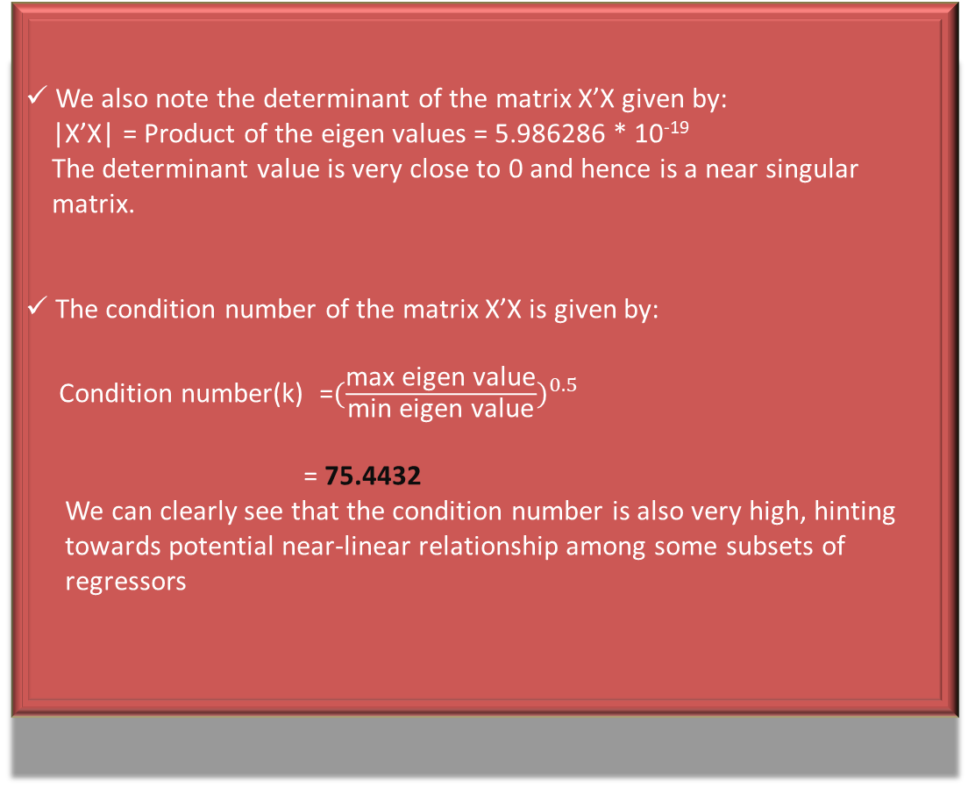
Stability of X’X
We also note the determinant of the matrix X’X given by:
|X’X| = Product of the eigen values = 5.986286 * 10⁻¹⁹
The determinant value is very close to 0 and hence is a near singular
matrix.
The condition number of the matrix X’X is given by:
Condition number(k) =${(\frac{\text{max} \text{eigen} \text{value}}{\text{min} \text{eigen} \text{value}})}^{0.5}$
= 75.4432
We can clearly see that the condition number is also very high, hinting
towards potential near-linear relationship among some subsets of
regressors

Slide 42
CONCLUSION FROM PRIMA FACIE DETECTION
We have shown that, the matrix X’X is near singular and ill-conditioned with a large condition number and also the pairwise correlation matrix has some large entries.

Slide 43
CONCLUSION FROM PRIMA FACIE DETECTION
We have shown that, the matrix X’X is near singular and ill-conditioned with a large condition number and also the pairwise correlation matrix has some large entries.
Thus, we can observe that there are some reasons to believe prima facie that our model may be affected by multicollinearity. So, we would perform further analysis on it to detect the regressors which are mainly responsible for multicollinearity.

Slide 44
METHODOLOGICAL DETECTION AND DIAGNOSTICS
VARIANCE INFLATION FACTOR :
VIF is calculated for parameters corresponding to each regresor.
It provides an index that measures the inflation in the variance of an estimated regression coefficient due to collinearity.

Slide 45
METHODOLOGICAL DETECTION AND DIAGNOSTICS
VARIANCE INFLATION FACTOR :
VIF is calculated for parameters corresponding to each regresor.
It provides an index that measures the inflation in the variance of an estimated regression coefficient due to collinearity.
VIF is calculated as:
VIF_{j} = (1-R_{j}²)⁻¹
where j = 1,2,...,p and R_{j}² = Coefficient of determination when x_{j} is
regressed with other regressors.

Slide 46
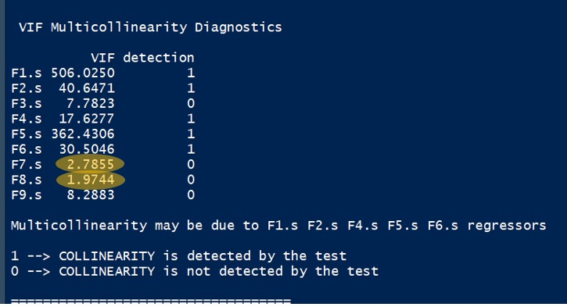
CALCULATED VIF FOR ALL THE PARAMETRES
Yellow marked VIF’s are less than 5
we tend to drop the regressor having highest VIF among those having VIF>5.

Slide 47
2. VARIANCE DECOMPOSITION METHOD :
As VIF does not provide us the information that which subset of regressors are basically responsible for multicollinearity so we now go for Variance Decomposition Method.
We used Singular Value Decomposition of the input matrix X to calculate variance decomposition of the estimated parameters along various singular values.

Slide 48

2. VARIANCE DECOMPOSITION METHOD :
As VIF does not provide us the information that which subset of regressors are basically
responsible for multicollinearity we now go for Variance Decomposition Method.
We used Singular Value Decomposition of the input matrix X to calculate variance decomposition of the estimated parameters along various singular values.
The variance decomposition matrix (Л) is calculated as:
X = UDV^{T}
Л_{kj} =$\frac{\text{(}\text{vkj}\text{2}\text{ /}\text{λ}\text{k}\text{)} }{\text{( }\text{Σ}\text{k} \text{v}\text{kj}\text{2}\text{ /}\text{λ}\text{k}\text{)} }$ ,for all k,j = 1,2,...,p

Slide 49
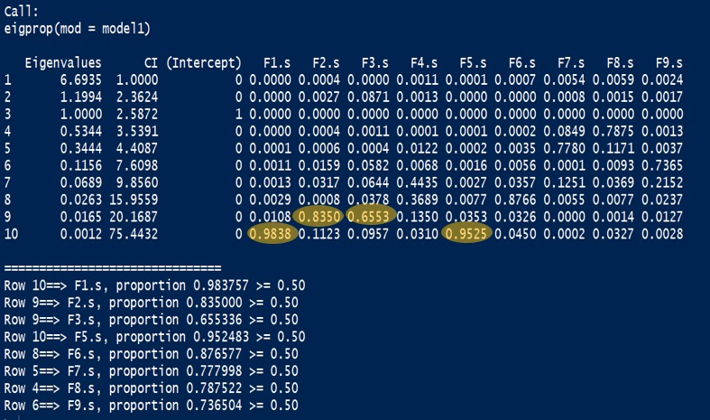
VARIANCE DECOMPOSITION OF ORIGINAL MODEL
STEP 1 :
In row 9 (condition index > 15) , (F2,F3) might be involved in multicollinearity.
In row 10 (condition index > 15) , (F1,F5) might be involved in multicollinearity.
Now, VIF_{F1} > VIF_{F5} , so we drop F1.
VIF_{F2} > VIF_{F3} , so we drop F2.

Slide 50
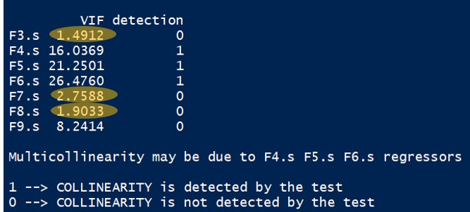
CALCULATED VIF FOR THE PARAMETRES OF THE REDUCED MODEL IN STEP 1
Yellow marked entries indicate VIF < 5
We observe VIF>5 for the regressors F4, F5, F6 and F9. Therefore, by VIF method
we may say this model still has multicollinearity due to these regressors.
For the detection of subset we again check for Variance decomposition method.

Slide 51
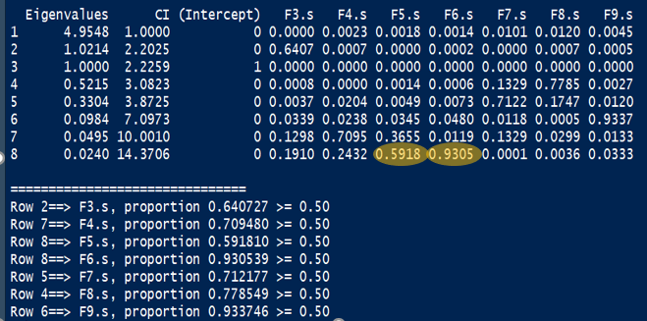
VARIANCE DECOMPOSITION OF REDUCED MODEL IN STEP 1
STEP 2 :
In row 8(condition index almost = 15), F5,F6 have high Л_{kj} values, hence they may be
involved in multicollinearity.
VIF_{F6} > VIF_{F5} , hence we drop F6.

Slide 52
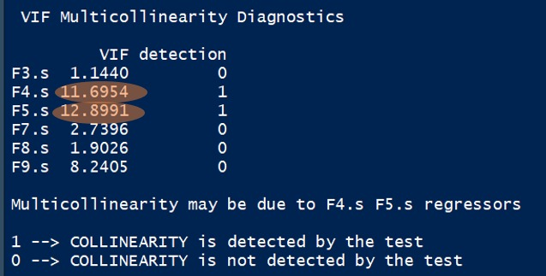
CALCULATED VIFs FOR THE PARAMETRES OF THE REDUCED MODEL IN STEP 2
Evidently, F4 and F5 , due to having high VIFs , are suspected to be
involved in multicollinearity.
For assurance we proceed to variance decomposition with this reduced
model.

Slide 53
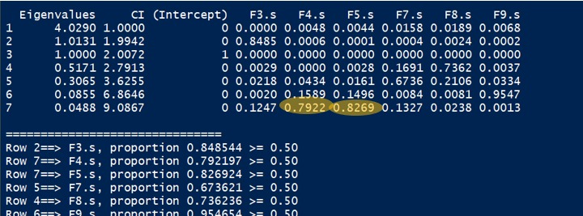
VARIANCE DECOMPOSITION OF REDUCED MODEL IN STEP 2
STEP 3 :
All the condition indices are < 15, so apparently by theoretical thumb rule we should have ignored the group formation and can claim that this underlying model is the final model and is free from multicollinearity.
But in row 7, F4 and F5, having high Л_{kj} values, are susceptible to multicollinearity.

Slide 54
Also, the pairwise correlation coefficient between standardized regressors X4 and X5 (corresponding to F4 and F5 respectively) is very high 0.936.
Not only that, VIF values are also very high corresponding to these two regressors under this model.
We proceed to check whether F5 can be explained by F4 or not so that we can drop F5 for having the higher value of VIF between F4 and F5.

Slide 55
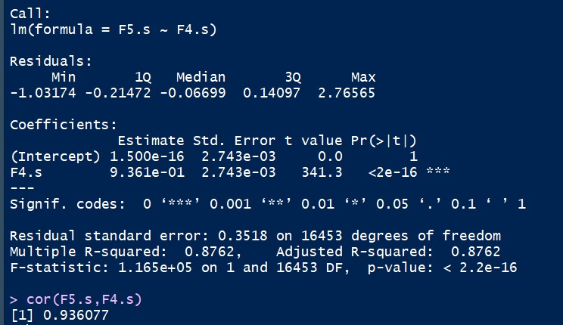
SUMMARY TABLE FOR SLR F5 ~ F4
Due to significant relation between F4 and F5 , we drop F5 ( higher VIF ) though
the condition number=9.0867 < 15
With the similar proceeding and due to its high VIF , F9 (high correlation with F4)
is dropped also.

Slide 56
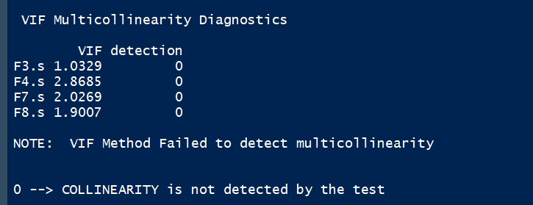
CALCULATED VIFs FOR THE PARAMETRES OF THE REDUCED MODEL IN STEP 3
VIF of all 4 regressors are well under 5
we proceed for variance decomposition.

Slide 57
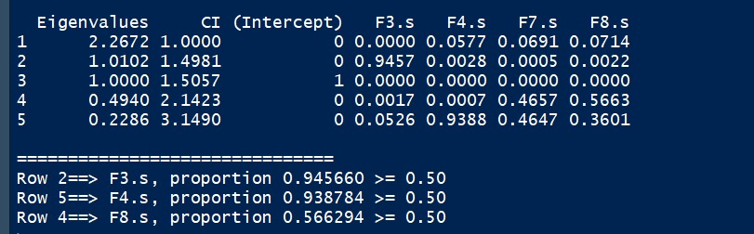
VARIANCE DECOMPOSITION OF REDUCED MODEL IN STEP 3
So, we can observe that under this reduced model there does not
exist any subset of regressors causing multicollinearity in the model.

Slide 58
Comparison of Condition no
For the reduced model minimum eigen value of X’X becomes 0.2286 which
is quite larger than 0 where as for the original model the minimum eigen
value of X’X was 0.001176 which might be responsible for the instability of
X’X under the original model.

Slide 59
Comparison of Condition no.
For the reduced model minimum eigen value of X’X becomes 0.2286 which
is quite larger than 0 where as for the original model the minimum eigen
value of X’X was 0.001176 which might be responsible for the instability of
X’X under the original model.
Condition number of X’X under original model=75.4432 (ill-conditioned)

Slide 60
Comparison of Condition no.
For the reduced model minimum eigen value of X’X becomes 0.2286 which
is quite larger than 0 where as for the original model the minimum eigen
value of X’X was 0.001176 which might be responsible for the instability of
X’X under the original model.
Condition number of X’X under original model=75.4432 (ill-conditioned)
Condition number of X’X under reduced model=3.1490

Slide 61
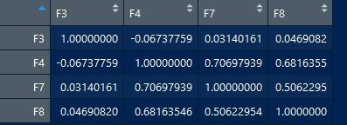
CORRELATION MATRIX UNDER REDUCED MODEL
We see that any pair of regressors are not highly correlated.

Slide 62
3. REDUCED MODEL :
Y = β₀ + β₃X₃+ β₄X₄+ β₇X₇+ β₈X₈+ ε

Slide 63
A REMEDY OF MULTICOLLINEARITY
RIDGE REGRESSION

Slide 64

OUTLINE
We obtain the ridge parameter estimates by minimizing the (Y −Xβ)’(Y −Xβ)+λβ’β constrained on β’β ≤ d² (say), where λ is the shrinkage/complexity parameter that controls the amount of shrinkage.
The ridge estimate is given by:
$\hat{ \text{β}\text{R}}$ = (X’X + λI)⁻¹ X’Y
Thus λ is a positive constant added to the diagonal elements of X’X, so that (X’X + λI) is not near singular and (X’X + λI)⁻¹ is no longer unstable.

Slide 65
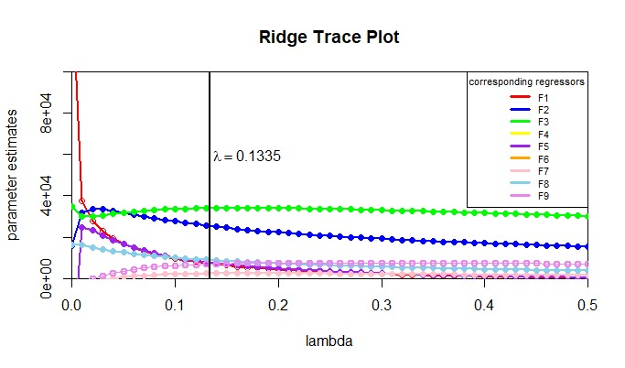
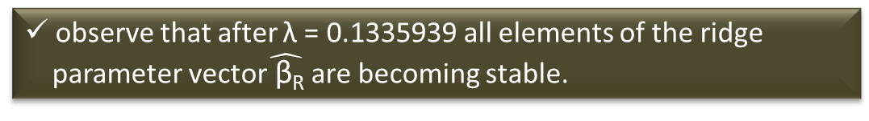
RIDGE TRACE
observe that after λ = 0.1335939 all elements of the ridge
parameter vector$\hat{ \text{β}\text{R}}$ are becoming stable.

Slide 66
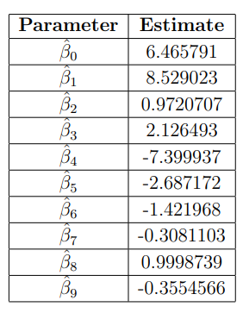
ESTIMATE OF β UPON RIDGE REGRESSION

Slide 67
Hence on final calculation after ridge regression the model turns out to be:
RMSD = −0.7103491 + 0.001975163*F1 + 0.0006459997*F2 + 31.00019*F3 − 0.1173224*F4 − 4.479266 × 10⁻⁶*F5 − 0.0189902*F6 − 0.0002242405*F7 + 0.01718049*F8 − 0.05516927*F9

Slide 68
Hence on final calculation after ridge regression the model turns out to be:
RMSD = −0.7103491 + 0.001975163*F1 + 0.0006459997*F2 + 31.00019*F3 − 0.1173224*F4 − 4.479266 × 10⁻⁶*F5 − 0.0189902*F6 − 0.0002242405*F7 + 0.01718049*F8 − 0.05516927*F9
Now we compare the variance of parameter estimates obtained by OLS
and Ridge regression

Slide 69
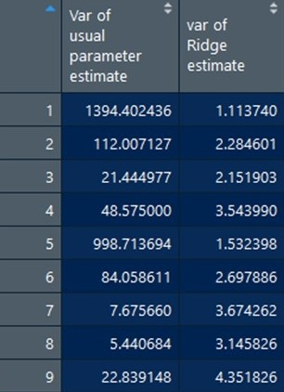
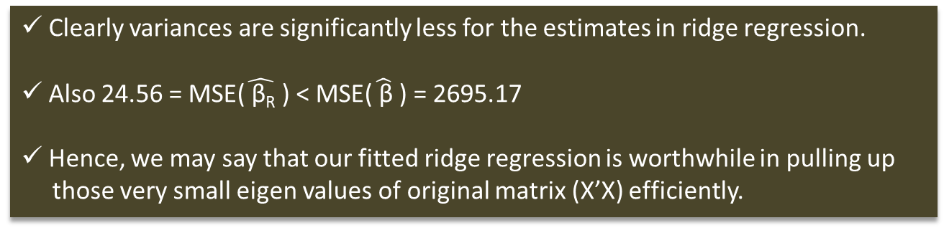
COMPARISON OF VARIANCE OF ESTIMATES OF 2 METHODS
Clearly variances are significantly less for the estimates in ridge regression.
Also 24.56 = MSE($\hat{ \text{β}\text{R}}$ ) < MSE($\hat{ \text{β}}$ ) = 2695.17
Hence, we may say that our fitted ridge regression is worthwhile in pulling up
those very small eigen values of original matrix (X’X) efficiently.

Slide 70
VARIABLE SELECTION

Slide 71
OUTLINE
Here our aim is to choose a subset of ‘best’ regressors (in some sense) from a pool of 9 possible regressors.
There are several ways of choosing this subset of ‘best’ regressors. In our analysis we shall use 2 model selection criteria viz Akaike Information Criterion and Mallow’s Cp Statistic.

Slide 72

AKAIKE INFORMATION CRITERION (AIC)
We calculate the AIC(p) using the formula,
AIC(p) = -2ln L* + 2p = n ln SS_{Res(p)} + 2p
where L* = max L(β, σ²|y) = L($\hat{ \text{β}\text{mle}}$,$\hat{ \text{σ}\text{2}\text{mle}}$ )
and 2p is the penalty term.
We compute AIC for all possible models and choose the model for which AIC is minimum.

Slide 73

MALLOW’S CP STATISTICS
We calculate Mallow’s cp statistics using the formula,
C_{p} = $\frac{\text{SS}\text{Res}\text{(}\text{p}\text{)}}{\hat{\text{σ}}\text{2}}$ + 2p – n
We shall consider the model for which C_{p} ≈ p for the first time.

Slide 74
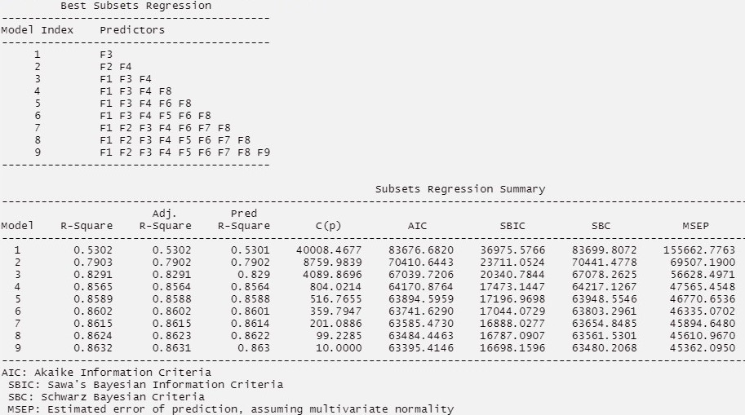
AIC AND MALLOW’S CP FOR DIFFERENT SUBSET OF REGRESSORS

Slide 75
OBSERVATION AND CONCLUSION
Based on the values seen, the value for Mallows Cp is indeed equal to 10 (the number of parameters) for Model 9.
Further on, we notice that model 9, involving all the regressors from the full model, is the one associated with the lowest value of AIC.
Hence by Variable Selection Technique, we end up with our full model itself.

Slide 76
MODEL ADEQUACY

Slide 77
Consider the model we got after eliminating multicollinearity
Y = β₀ + β₃X₃+ β₄X₄+ β₇X₇+ β₈X₈+ ε

Slide 78
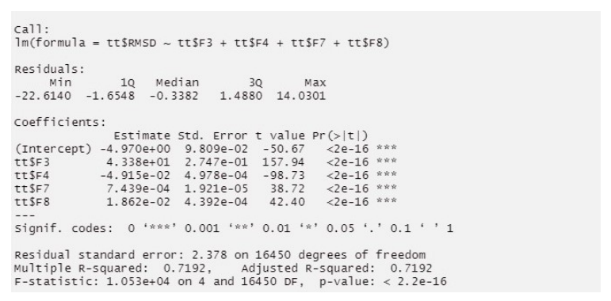
Consider the model we got after eliminating multicollinearity
Y = β₀ + β₃X₃+ β₄X₄+ β₇X₇+ β₈X₈+ ε
SUMMARY OF LEAST SQUARE ESTIMATE FOR REDUCED MODEL

Slide 79
OBSERVATION AND CONCLUSION
We get the values of R² and Adjusted R² to be 0.7192 and 0.7192 respectively, implying that about 71.92% of the variation in observed responses is explained by our assumed linear model.
Thus we can conclude that this model is quite efficient in explaining the dependence of the response (RMSD) on Fractional area of exposed non-polar residue (F3), Fractional area of exposed non-polar part of the residue (F4), Euclidean Distance (F7) and Secondary structure penalty (F8).

Slide 80

R² for Prediction :
Press statistic is obtained by the formula,
PRESS = Σ_{i} $\frac{ \hat{{{\text{є}}_{i}}^{2}}}{\text{(}\text{1 – }\text{hii}\text{)2 }}$
R² for prediction based on PRESS is given by,
R²_{PRESS} = 1 – $\frac{\text{PRESS}}{\text{SS}\text{Total}}$

Slide 81

R² for Prediction :
Press statistic is obtained by the formula,
PRESS = Σ_{i} $\frac{ \hat{{{\text{є}}_{i}}^{2}}}{\text{(}\text{1 – }\text{hii}\text{)2 }}$
R² for prediction based on PRESS is given by,
R²_{PRESS} = 1 – $\frac{\text{PRESS}}{\text{SS}\text{Total}}$
We get the value of PRESS as 93273.93.
Correspondingly, we get, ${{\text{R}}^{2}}_{\text{PRESS}}$ = 0.7184843. Therefore we would expect the model to explain about 71.85% of the variability in predicting new observations

Slide 82
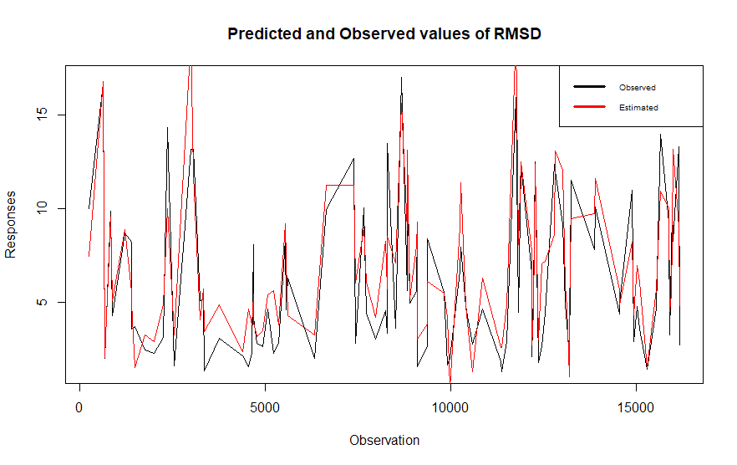
GRAPHICAL OVERVIEW OF THE MODEL
We can see from this plot that our model is quite efficient in
estimating the RMSD.

Slide 83
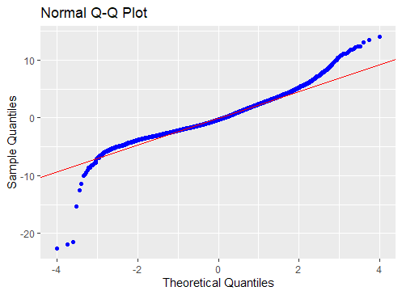
We can see that there is an indication that the errors may have heavier tails implying that the errors may not be normally distributed.

Slide 84

We can see that there is an indication that the errors may have heavier tails implying that the errors may not be normally distributed.
We can see that the nature of the plot is quite random. We do get a hint of association, but the nature of dependence is not clear.

Slide 85
Conclusion
We see that the dependence of protein’s tertiary structure is more efficiently explained by a subset of the 9 available regressors (i.e. F3, F4, F7 and F8) (71.92% effiecint in expianing the observed response variance) than by all the full model involving 9 regressors (28.23% effiecint in expianing the observed response variance) as we have seen that some of the regressors have a near-linear relationship amongst them.
We have also tried to keep the full model by allowing a trade-off between the biasness of the parameter estimates and their mean square errors. We have seen that although in doing so, we get biased estimates of the true model parameters, we however get estimates with lesser mean square errors that normal estimates.

Slide 86
Conclusion
We have made attempts to select a subset of regressors which explain the response most effiecient by looking at the AIC and Mallow’s Cp of different subset models. We however have found that in doing so, we get back our full model itself.
We consider the final model as the one including regressors which do not have near-linear relationship amongst themselves.

Slide 87
THANK YOU

